Slide 1
Orbital Kinematics of eta Carinae during Periastron
Emily Strawn April 17, 2021
Dr. noel Richardson Connor Pickett Alexis Lane

Slide 2
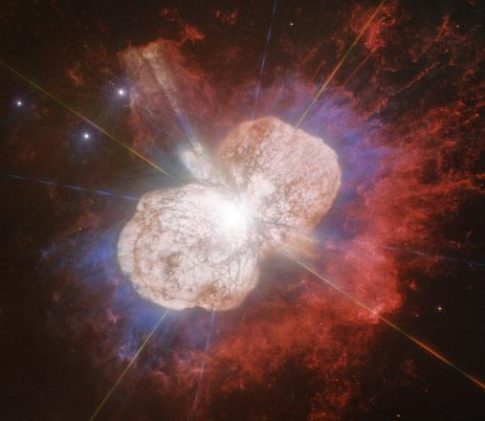
eta Carinae
Binary System in Carinae Nebula
19th Century Large Eruption Creates Homunculus Nebula
Periastron – closest point in orbit
Source: apod.nasa.gov

Slide 3
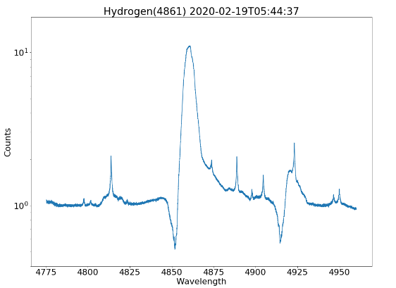
Hydrogen Emissions
Strong Emissions – More Precise Analysis
P-Cygni Absorption due to Wind-Wind Collisions

Slide 4
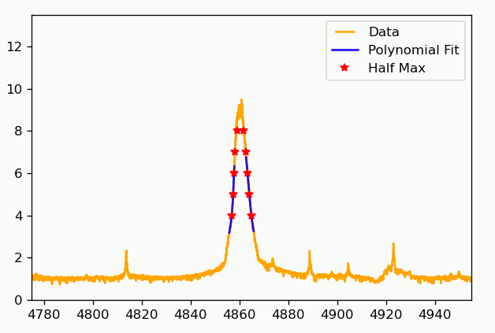
Radial Velocity
Half Mass Bisector
Used Polynomial Fits
Averaged for range of heights

Slide 5
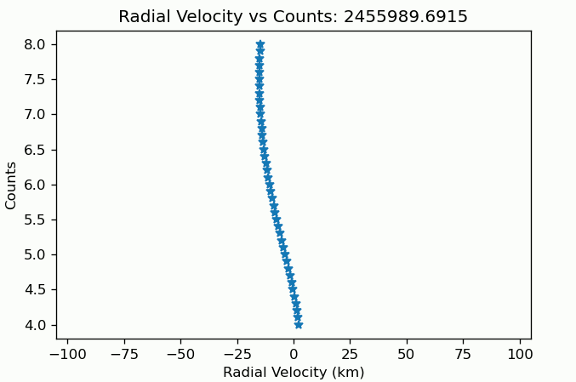
Radial Velocity
Plot to find Relevant Range (Counts = [5,6])
Observable Increase and Decrease of Velocity

Slide 6
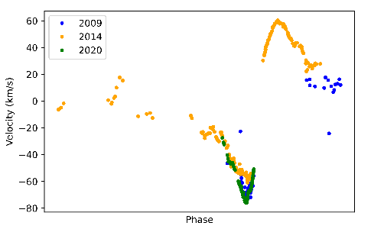
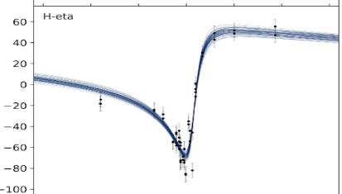
Conclusion
Compare Three Previous Periastron Cycles
Consistent with motion of the binary, and recent results of Grant et al.
Source: Grant et al., 2020

